Slide 1
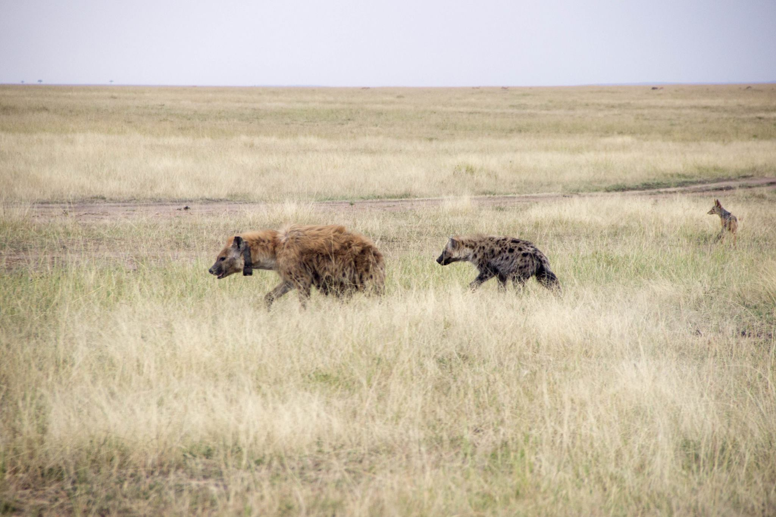
Hyenas, microbes, R and more!
Connie A. Rojas
Michigan State University
Integrative Biology
Ecology, Evolutionary Biology, and Behavior
P.C. Lily Johnson-Ulrich
Notes:
Hello everyone, my name is Connie and I am a 4th year PhD Student in the Department of Integrative Biology
And the ecology, evolutionary biology, and behavior program here at MSU.
During this lighting talk, I will share a bit about how I use R for my research.

Slide 2
My dissertation research focuses on the interactions between animals and their microbial communities
Notes:
My dissertation research focuses on the interactions between animals and their microbial communities inhabiting their bodies

Slide 3
How microbes influence their animal host’s physiology and behavior
Notes:
I study both how microbes influence their host’s physiology and behavior

Slide 4
How hosts influence their associated microbial communities
How microbes influence their animal host’s physiology and behavior
Notes:
And how the hosts themselves may be influencing their microbial communities.
This is a very exciting field of research, as we are just beginning to understand all the ways microbes may be
Affecting us!

Slide 5
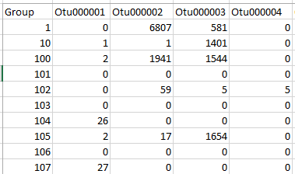
The data
Bacterial species (27,000)
Counts of that bacterial sp. in a particular sample
samples (200-300)
Notes:
The main table that I work with and load into R is one that has bacterial species as columns and samples as rows. And each cell represents counts of a particular bacterial species in each sample
My table is very large and impossible to work with in Excel.

Slide 6
The data
Bacterial species (27,000)
Counts of that bacterial sp. in a particular sample
samples (200-300)
Meta data (identifying information for each sample)
Notes:
The main table that I work with and load into R is one that has bacterial species as columns and samples as rows. And each cell represents counts of a particular bacterial species in each sample
My table is very large and impossible to work with in Excel.

Slide 7
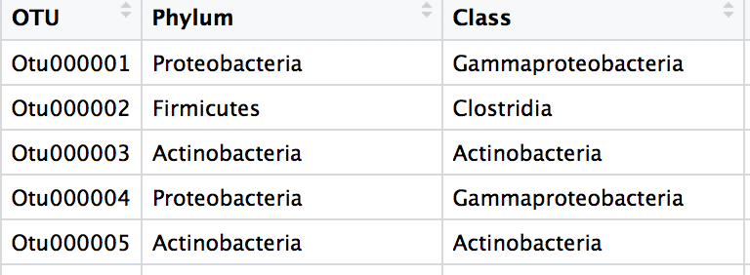
The data
Bacterial species (27,000)
samples (200-300)
Notes:
The main table that I work with and load into R is one that has bacterial species as columns and samples as rows. And each cell represents counts of a particular bacterial species in each sample
My table is very large and impossible to work with in Excel.

Slide 8
Heatmaps to visualize community composition
Notes:
In R, I do things like heatmaps, which show the abundances of major bacterial groups in each body site

Slide 9
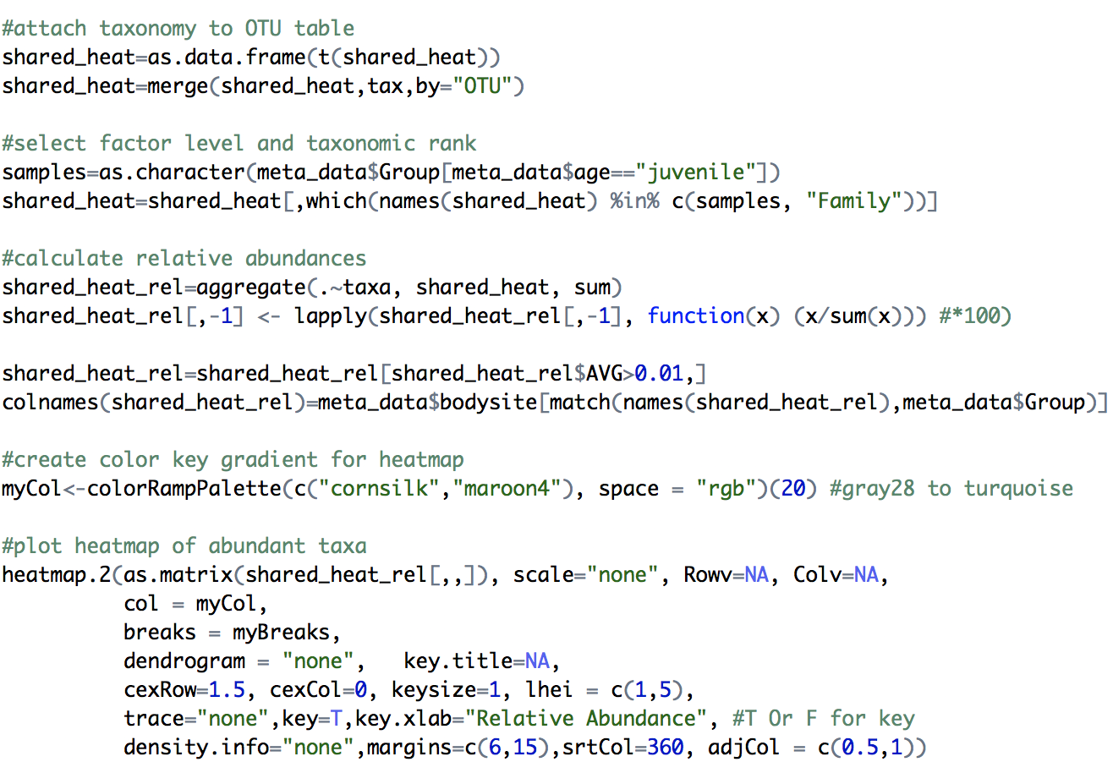
Heatmaps to visualize community composition
Notes:
In R, I do things like heatmaps, which show the abundances of major bacterial groups in each body site

Slide 10
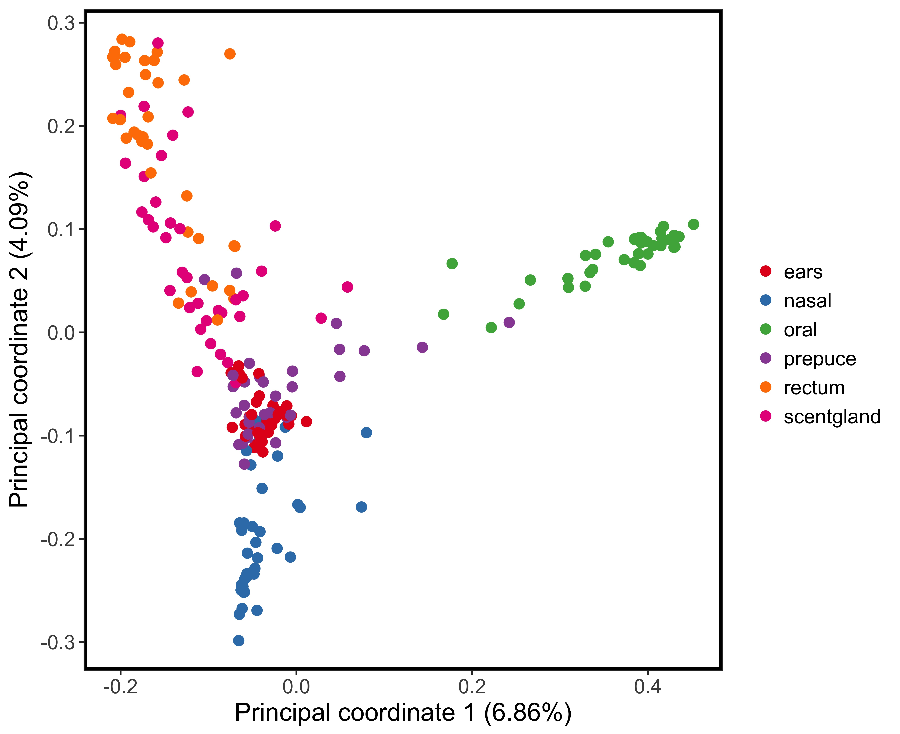
PCoA to visualize community similarity
Notes:
I also do principal coordinates analysis to see how samples compare to one another. Here, the closer samples (i.e. points) are, the more similar their bacterial communities.
Here, you can see that bacterial communities partition by niche.

Slide 11
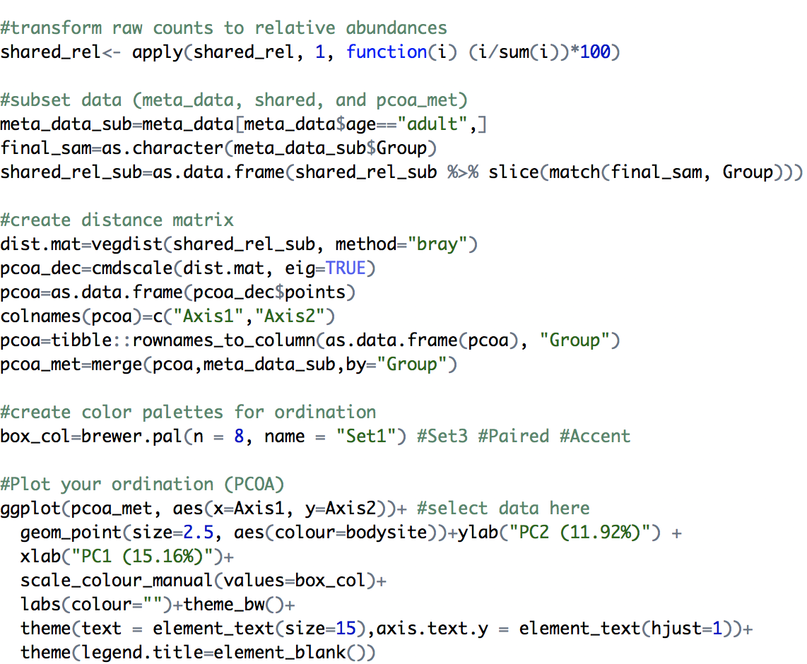
PCoA to visualize community similarity
Notes:
I also do principal coordinates analysis to see how samples compare to one another. Here, the closer samples (i.e. points) are, the more similar their bacterial communities.
Here, you can see that bacterial communities partition by niche.

Slide 12
Thank you for listening!
rojascon@msu.edu
@ConnieLaBiologa
rojascon
Notes:
Thank you for listening and here is my contact information in case you have any questions!

